Slide 1
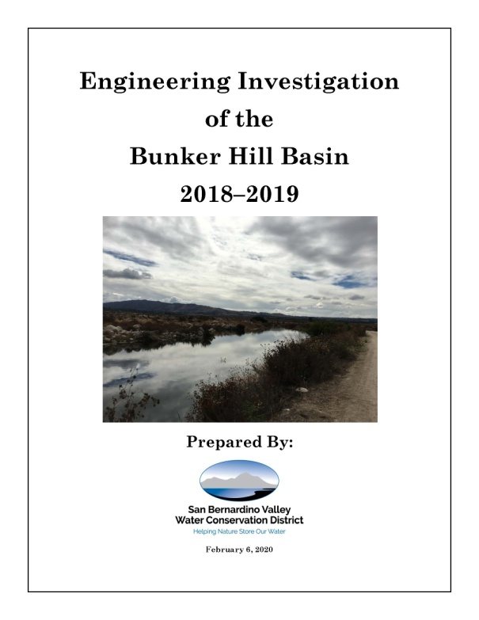
Engineering Investigation of the Bunker Hill Basin
2018 – 2019
March 11, 2020
Presentation of Findings
SBVWCD Board of Directors & BTAC
Based on Data Received through January 30, 2020

Slide 2
Purpose of EI
Article 1, Section 75560 of the California Water Code requires that a Water Conservation District proposing to levy a ground water charge “…shall annually cause to be made an engineering investigation and report upon ground water conditions of the District.”
Beyond this it has value as an independent statement of the status of the basin

Slide 3
Planning and Production
Plan approved by the SBVWCD Board
Requested data from entities and other data sources
Prepared report analysis with the 2005 basis as we did in 2019
Calculated values and produced charts, maps graphics and report
Review comments will be incorporated into final report

Slide 4
Who Worked on the EI
Katelyn Scholte: Data Management, Calculations, Draft Report, Maps, and Draft Preparation
Erwin Fogerson and Daniel Cozad: Project Management and Review
Basin Producers: Well Elevation and Production

Slide 5
Collaborators and Data Needs
Agencies Involved :
Data Provided:
• City of Colton
• City of Loma Linda
• City of Redlands
• City of Rialto
• City of Riverside
• City of San Bernardino
• East Valley Water District
• Fontana Water Company
• Loma Linda University
• Meeks and Daley Water Company
• Riverside Highland Water Company
• San Bernardino Valley Municipal Water District
• Southern California Edison
• United States Geological Survey
• West Valley Water District
Well Elevations
Well Production
Water Quality Data
GIS Locations
Precipitation Data
Gaging Station Data
Diversion Data

Slide 6
Steps Involved to Creating the EI
Request Production and Water Level Data
Enter Data into Database and Appendices
Perform Quality Control and cross checks
Perform Analysis by Groundwater Basin
Calculate Task answers
Generate maps
Prepare or update report text
Present to Board and Basin Producers

Slide 7
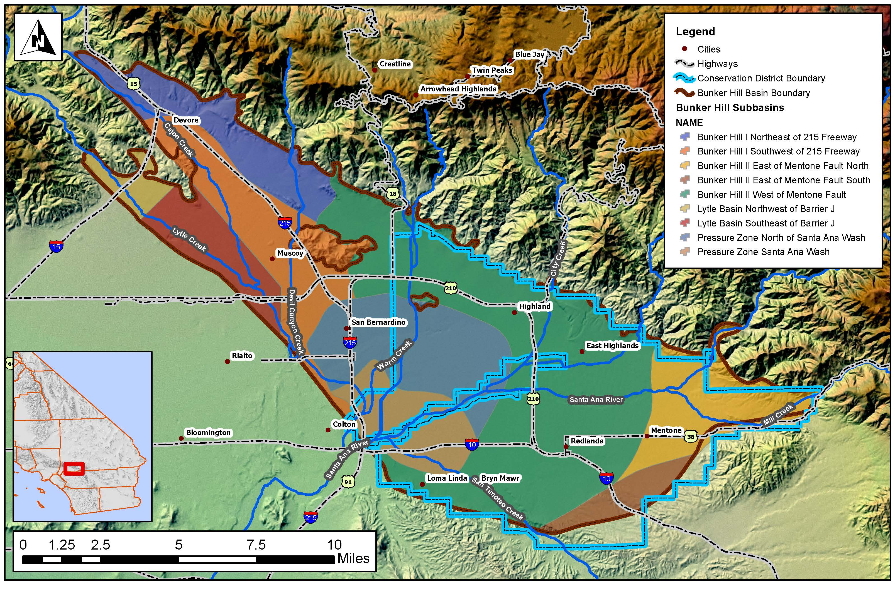
Bunker Hill Sub-Basins

Slide 8
Task 1: Analysis Methodology
Current Year’s Level From The Previous Water Elevation Levels’ Values Yielded A Positive Value.
Groundwater
Levels in 2019
Groundwater
Level 2018
-
=
Change in storage
152,408 acre-ft
(increase)
Year | Task 1 |  | Year | Task 1 |  | Year | Task 1 |  | Year | Task 1
03-04 | -68,100 |  | 07-08 | -2,600 |  | 11-12 | -89,775 |  | 15-16 | 16,820
04-05 | 223,800 |  | 08-09 | -35,600 |  | 12-13 | -129,945 |  | 16-17 | 43,625
05-06 | -62,400 |  | 09-10 | 56,977 |  | 13-14 | -91,555 |  | 17-18 | -47,788
06-07 | -113,900 |  | 10-11 | 116,020 |  | 14-15 | -47,570 |  | 18-19 | 152,408

Slide 9
Task 1: Annual Change in Storage
"storage properties"
152,408 acre-ft (increase)
From Appendix A

Slide 10
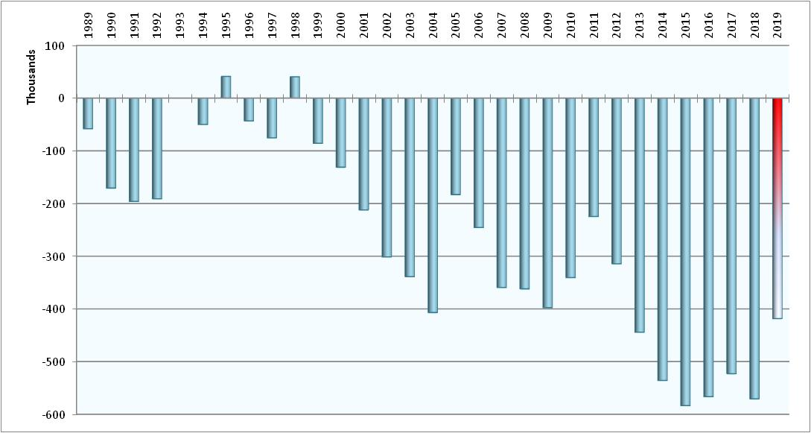
Task 2: Accumulated Change in Storage in the Bunker Hill Basin
-418,310 acre-ft (decrease)
-from 1993

Slide 11
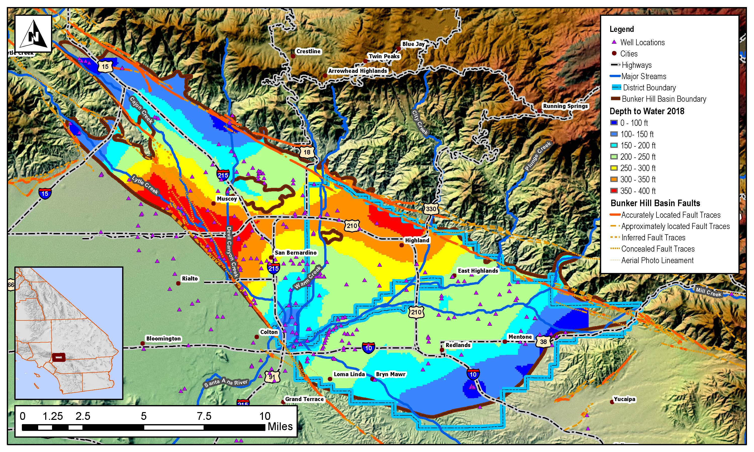
Water Elevations 2018

Slide 12
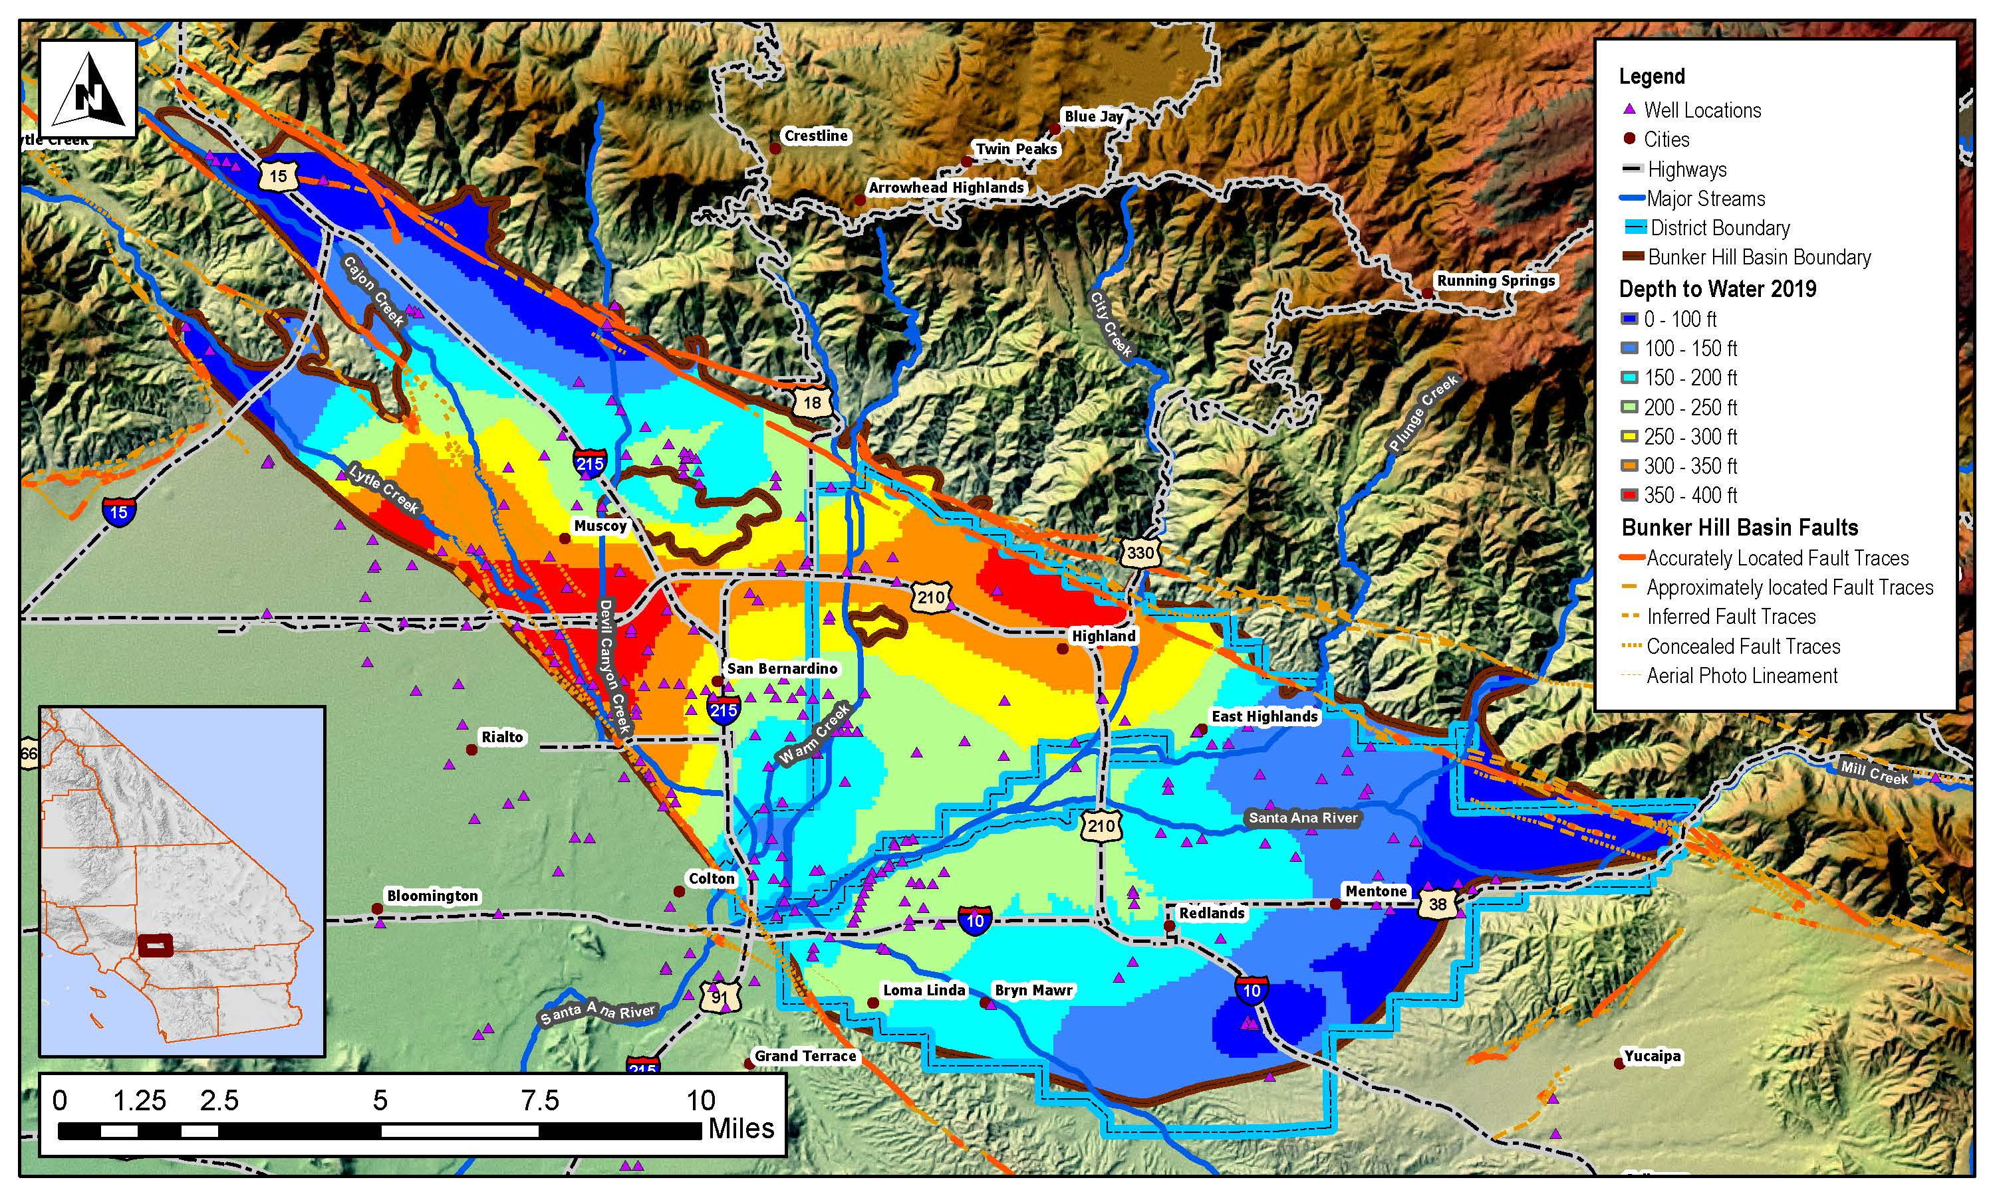
Water Elevations 2019

Slide 13
Task 3: Groundwater Production from the Bunker Hill Basin
Basin Production (Acre Feet)
157,354 acre-ft
161,708 acre-ft (2017-2018)

Slide 14
Task 4: Estimated Annual Change in Storage
Current Year (July 1, 2019- June 30, 2020)
27,658 acre-ft (increase)
-77,559 acre-ft (2018-2019)

Slide 15
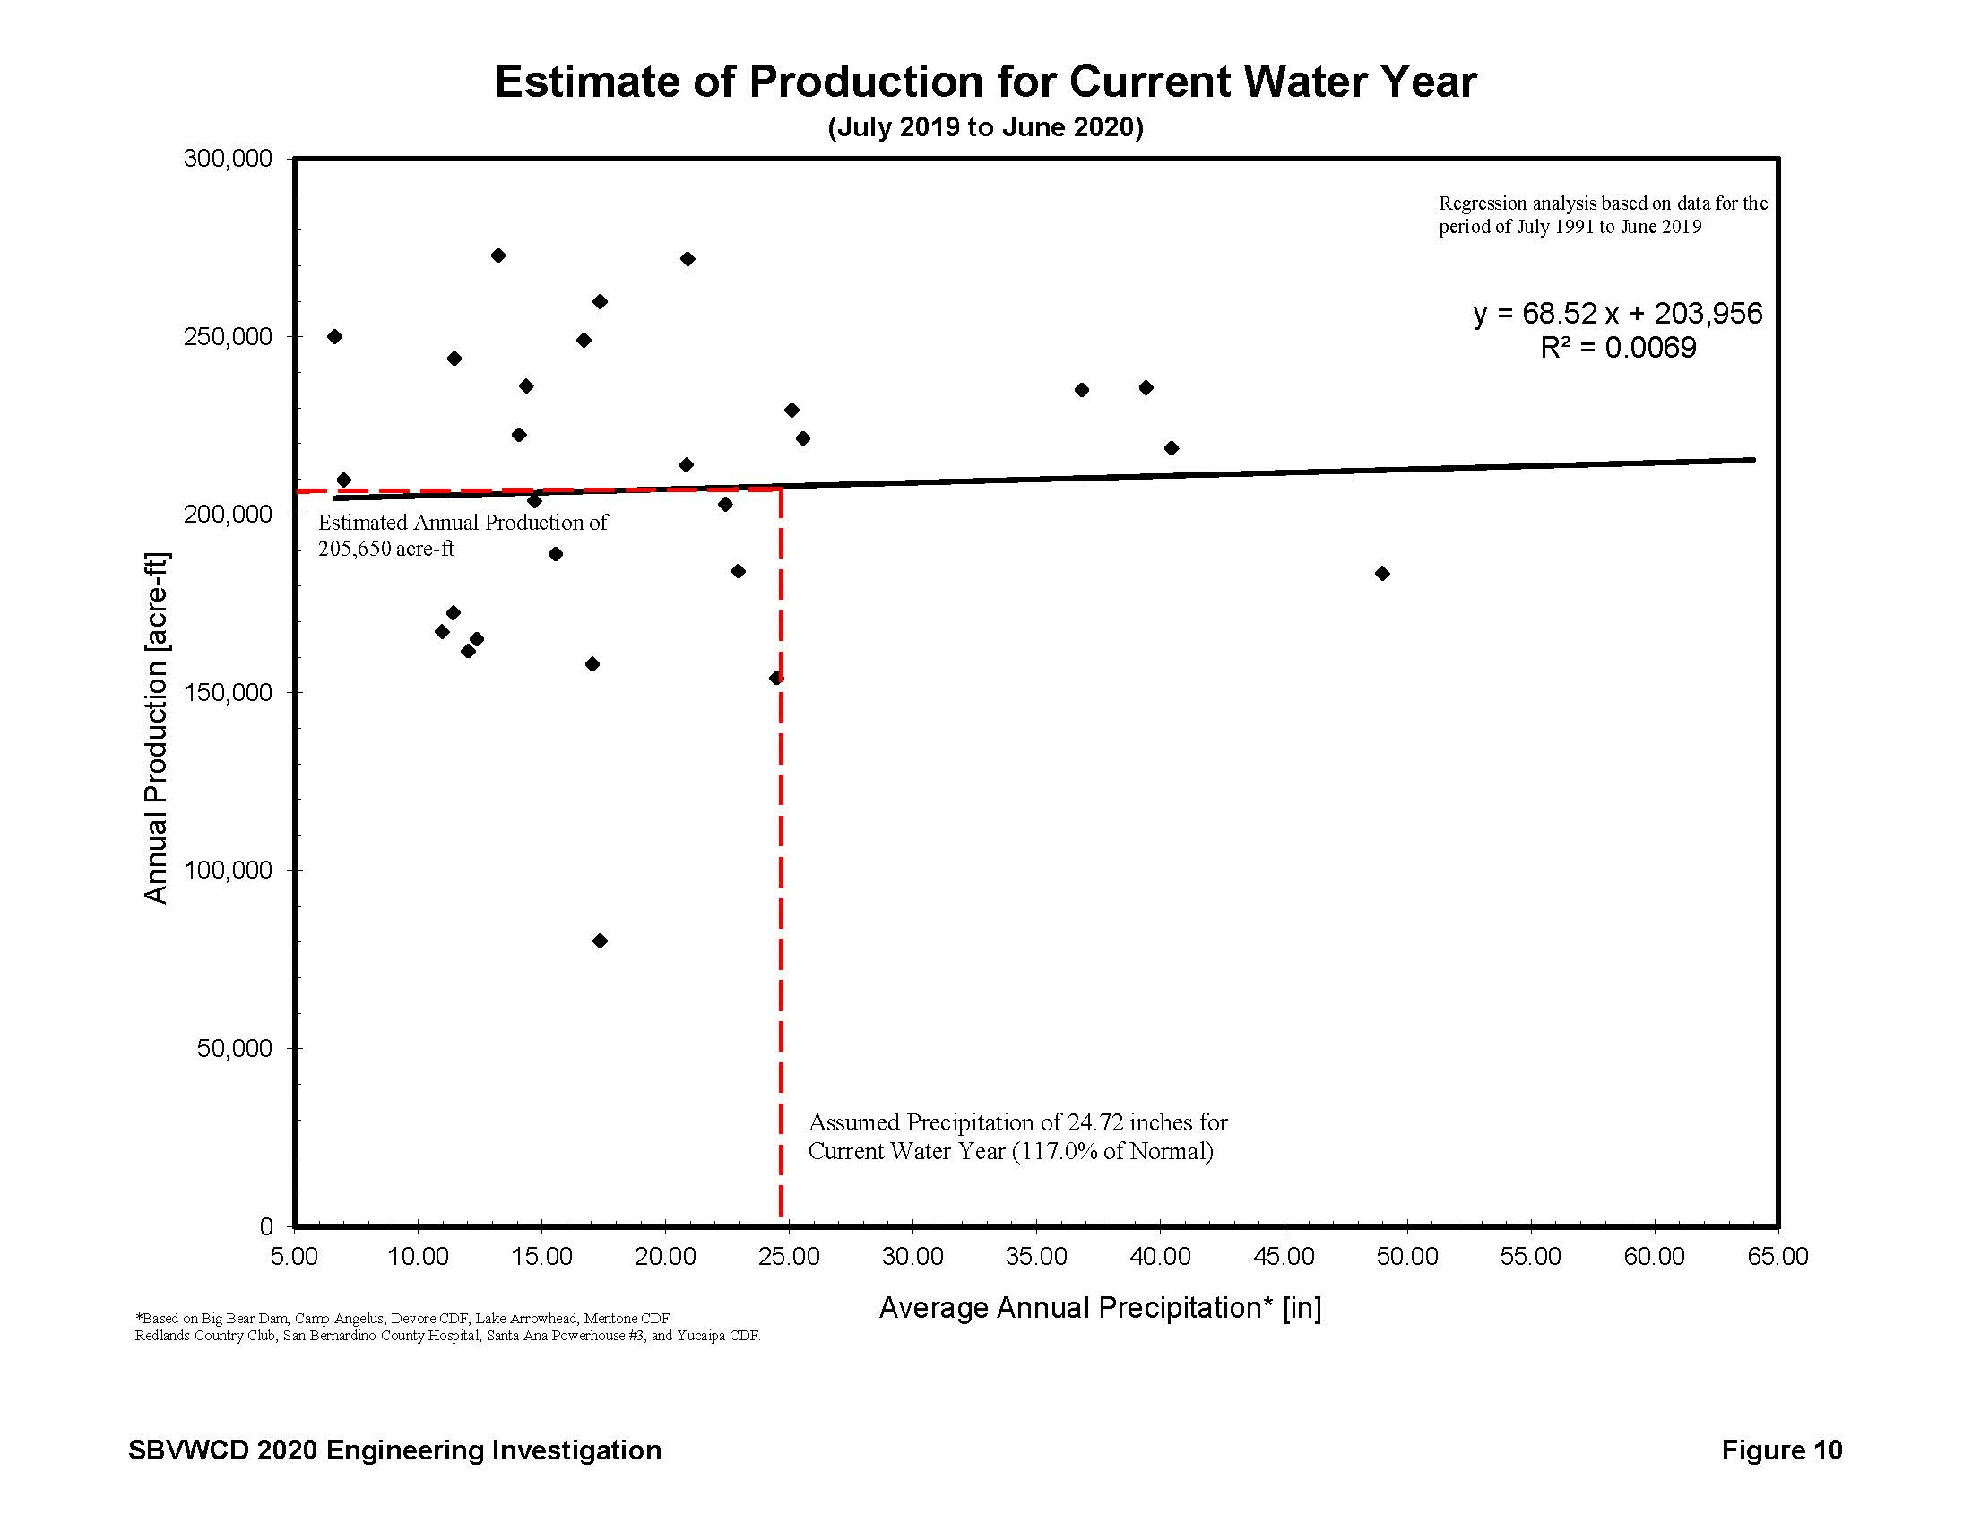

Slide 16
Task 5: Estimated Annual Change in Storage
Ensuing Water Year
(July 1, 2020 – June 2021)
100% of Average
-1,923 acre-ft (decrease)
-5,973 acre-ft (2018-2019)
50% of Average
-85,832 acre-ft (decrease)
150% of Average
+85,985 acre-ft (increase)

Slide 17
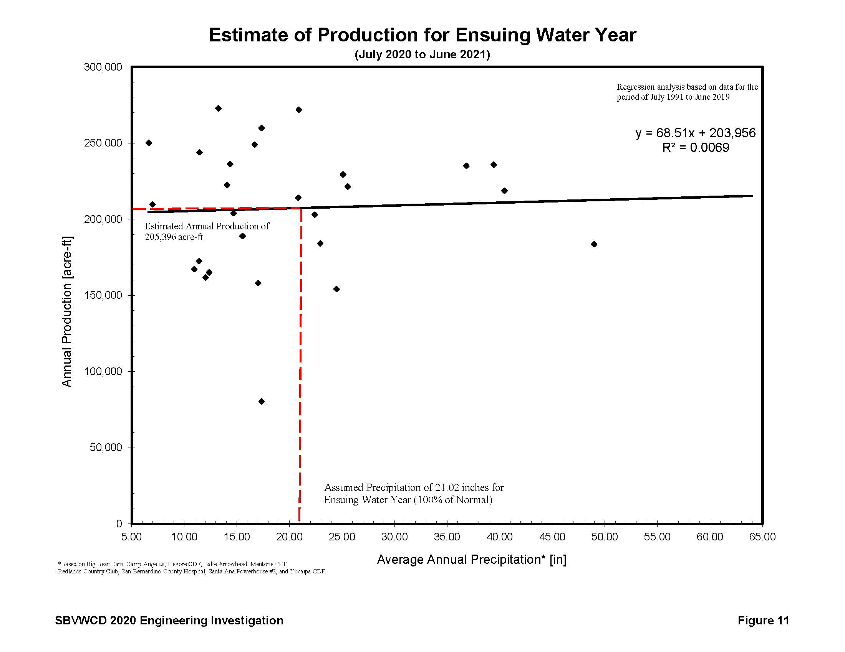

Slide 18
Change in Storage Prediction

Slide 19
Task 6: Average Annual
Change in Storage
-3,407 acre-ft (decrease)
-14,011 acre-ft (decrease) (2019)

Slide 20
Task 7: Estimated Production from District Boundaries
Ensuing Water Year (2020-2021)
11,207 acre-ft (historically agricultural)
11,065 acre-ft (ag, previous)
86,772 acre-ft (non-agricultural)
95,056 acre-ft (non-ag, previous)

Slide 21
Task 8: Estimated Surface Diversion from Basin and District
Ensuing Water Year (2020-2021)
79,857 acre-ft (Basin)
76,743 acre-ft (Basin/2018-2019)
56,415 acre-ft (District)
53,963 acre-ft (District/2018-2019)

Slide 22
Task 9: Estimated Replenishment Required for Constant Storage
(Ensuing Water Year)
Indicates the groundwater replenishment from all sources, including natural recharge, required so that no net change occurs in groundwater storage for the ensuing water year.
Replenishment = Production – Surface Diversions + Change in Storage

Slide 23
Task 9: Estimated Replenishment Required for Constant Storage
July 1, 2020 – June 30, 2021
(Ensuing Water Year)
127,462 acre-ft (Basin)
136,545 acre-ft (Basin/2018-2019)
99,902 acre-ft (District)
112,094 acre-ft (District/2018-2019)

Slide 24
Task 9: Replenishment Required to Reach the 1993 “Full” Level
(Ensuing Water Year)
518,114 acre-ft
784,822 acre-ft (2018-2019)
Sum of the preceding year accumulated change in storage (Task 2), the current year annual change in storage (Task 4), and the ensuing year replenishment figure (Task 9).

Slide 25
Acre Feet of Native and Imported Water Recharged to the Bunker Hill Basin by the District
Total from 1912-2019
Over 1.2 Million Acre Feet Water

Slide 26
Acre Feet of Imported Water Recharged to the Bunker Hill Basin by the District
Total from 1971-2019
Over 92,000 Acre Feet Imported Water

Slide 27
Acre Feet of Conserved Water Recharge to the Bunker Hill Basin

Slide 29
Also Timing Requires Rate Setting
The EI is a Requirement for Rate Setting
Rate Setting based on Draft Budget
Preliminary review of the budget February 12
Present options of rate changes to Board
Advertise and Notice a Rate
Work with all to find the right rate
Public Meeting – April 8, 2020
Public Hearing – April 22, 2020

Slide 30
Historic District Production

Slide 31
Groundwater Council Proposal
2020-2021 SBVWCD Groundwater Enterprise Budget
Groundwater Charge Agriculture – Ag Phase in Year 3 | $128,045
Groundwater Charge Non-Agriculture (5% increase) | $331,677
Groundwater Council SBVWCD | $600,000 GC
Groundwater Council (for San Bernardino County Flood) | $70,000 Pass through
SBVMWD Lease/Exchange Plan | $232,839
 | $1,362,561
Estimated Groundwater Charge Paid entities included in GC Initial Year
Estimated Groundwater Charge Redlands | $0
Estimated Groundwater Charge Western Entities | $227,500
 | $227,500

Slide 32
Potential Rate Options

Slide 33
Revenue Budget
GL ACCT: | GL DESCRIPTION: | Approved 2019-2020 Budget | Projected Annual Costs (7/1/19-6/30/20) | Draft 2020-2021 Budget | GROUNDWATER RECHARGE ENTERPRISE
Draft 2020-2021 Budget |  |  |  |  | 2020 BUDGET: | % BUDGET | BASIS:
 | INCOME:
4012 | INTEREST INCOME-LAIF | 20,000.00 | 2,000.00 | 2,400.00 | 0.00
4013 | INTEREST INCOME-CALTRUST | 66,443.10 | 76,021.36 | 79,822.43 | 0.00 |  | Groundwater Totals
4014 | INTEREST INCOME-CA CREDIT UNION | 3,600.00 | 3,600.00 | 3,672.00 |  |  | $ 1,129,722
4015 | INTEREST INCOME-UBS | 36,000.00 | 36,000.00 | 36,720.00 |  |  | $ 459,722
4016 | INTEREST INCOME ARTP | 450,000.00 | 450,000.00 | 459,000.00 |  | 0.00%
4021 | GROUNDWATER CHARGE-AG | 97,028.35 | 47,028.35 | 128,045.00 | 128,045.00 | 100.00% | PER OFFSET
4023 | GROUNDWATER CHARGE-NON AG | 405,830.40 | 405,830.40 | 331,676.79 | 331,676.79 | 100.00% | 5% INCREASE
4024 | GROUNDWATER COUNCIL REVENUE | 470,000.00 | 543,847.00 | 670,000.00 | 670,000.00 | 100.00% | PROPOSED
4031 | PLANT SITE CEMEX | 48,000.00 | 48,000.00 | 48,000.00 | 0.00
4032 | CEMEX - ROYALTY/LEASE | 586,000.00 | 586,000.00 | 586,000.00 | 0.00
4036 | AGGREGATE MAINTENANCE | 40,000.00 | 40,000.00 | 40,000.00 | 0.00
4040 | MISCELLANEOUS INCOME | 10,000.00 | 10,000.00 | 10,000.00 | 0.00
4050 | PROPERTY TAX | 122,145.33 | 162,145.33 | 124,588.24 | 0.00
4055 | SBVMWD LEASE AGREEMENT | 411,013.69 | 407,061.64 | 423,344.11 | 232,839.26 | 55.00% | 0.6% EST. CPI-U CUURA421SA0
4062 | MENTONE PROPERTY INCOME | 100.00 | 100.00 | 100.00 | 0.00
4065 | REDLANDS PLAZA | 172,108.19 | 172,108.19 | 172,108.19 | 0.00
4066 | REDLANDS PLAZA CAM | 40,191.90 | 40,191.90 | 40,191.90 | 0.00
4080 | EXCHANGE PLAN | 30,000.00 | 130,000.00 | 30,000.00 | 30,000.00 | 100.00% | HISTORIC
4025 | WASH PLAN REVENUE * from Reserves | 210,000.00 | 210,000.00 | 210,000.00 | 0.00
4086 | PLUNGE CREEK IRWMP Grant | 200,000.00 | 200,000.00 | 200,000.00 | 0.00
4998 | RATE STABILIZATION *From Reserves | 22,223.00 | 22,223.00 | 22,223.00 | 22,223.00 | 100%
4999 | TRUST REIMBURSEMENT WASH PLAN | 100,000.00 | 100,000.00 | 100,000.00 | 0.00
 | TOTAL INCOME: | 3,540,683.96 | 3,692,157.17 | 3,717,891.65 | 1,414,784.05

Slide 34
Expense Budget
GL ACCT: | GL DESCRIPTION: | Approved 2019-2020 Budget | Projected Annual Costs (7/1/19-6/30/20) | Draft 2020-2021 Budget | GROUNDWATER RECHARGE ENTERPRISE
Draft 2020-2021 Budget |  |  |  |  | 2020 BUDGET: | % BUDGET | BASIS:
 | EXPENSES:
5080 | LAFCO CONTRIBUTION/FEES | 4,000.00 | 3,951.62 | 4,000.00 | 0.00
5120 | MISC. PROFESSIONAL SERVICES | 130,000.00 | 130,000.00 | 130,000.00 | 27,300.00 | 21.00% | GSC and Bio Support
5122 | WASH PLAN PROFESSIONAL SERVICES | 30,000.00 | 120,000.00 | 30,000.00 | 0.00
5123 | HABITAT MANAGEMENT-WP | 120,000.00 | 120,000.00 | 120,000.00 | 0.00
5124 | PLUNGE CREEK PROFESSIONAL SERVICES | 150,000.00 | 150,000.00 | 150,000.00 | 7,500.00 | 5.00%
5125 | ENGINEERING SERVICES | 18,000.00 | 18,000.00 | 18,000.00 | 18,000.00 | 100.00% | GENERAL ENG./GIS
5130 | AERIAL PHOTO/SURVEYING/MARKET | 1,000.00 | 6,000.00 | 1,000.00 | 0.00
5133 | Regional River HCP Contribution CIP #7 | 25,000.00 | 25,000.00 | 25,000.00 | 18,750.00 | 75.00%
5155 | WP TRAILS SERVICES | 25,000.00 | 25,000.00 | 25,000.00 | 0.00
5160 | IT SUPPORT | 7,000.00 | 7,000.00 | 7,000.00 | 3,500.00 | 50.00% | Share by need
5170 | AUDIT | 26,155.00 | 23,260.00 | 26,155.00 | 9,415.80 | 36.00% | Share based on Revenue
5175 | LEGAL-WASH PLAN | 20,000.00 | 20,000.00 | 20,000.00 | 0.00
5180 | LEGAL | 175,000.00 | 175,000.00 | 175,000.00 | 52,500.00 | 30.00% | GSC and COE Litigation
 | FIELD OPERATIONS:
5210 | EQUIPMENT MAINTENANCE | 6,365.40 | 6,365.40 | 6,556.36 | 6,556.36 | 100.00% | based on average actual
5215 | PROPERTY MAINTENANCE | 42,000.00 | 42,000.00 | 42,000.00 | 33,600.00 | 80.00% | Basin Maintenance Moved
5223 | TEMP FIELD LABOR | 11,000.00 | 11,000.00 | 11,000.00 | 11,000.00 | 100.00% | Invasive and canal cleaning
5225 | FIELD CLEAN UP-DUMPING/VECTOR | 60,000.00 | 60,000.00 | 60,000.00 | 36,000.00 | 60.00%
5050 | BASIN CLEANING FORMERLY 7050 CAPITAL | 50,000.00 | 50,000.00 | 50,000.00 | 50,000.00 | 100.00%
 | VEHICLE OPERATIONS:
5310 | VEHICLE MAINTENANCE | 8,000.00 | 8,000.00 | 8,000.00 | 8,000.00 | 100.00% | reduced from 2013-14 base
5320 | FUEL | 12,500.00 | 12,500.00 | 13,750.00 | 13,750.00 | 100.00% | EST. LOWER FUEL COST
 | UTILITIES:
5410 | ALARM SERVICE | 1,500.00 | 1,500.00 | 1,500.00 | 750.00 | 50.00% | FACILITIES SHARE
5420 | ELECTRICITY | 10,000.42 | 10,000.42 | 10,000.42 | 2,000.08 | 20.00% | FACILITIES SHARE
5430 | MOBILE PHONES | 3,550.00 | 4,365.02 | 5,265.00 | 3,948.75 | 75.00% | FACILITIES SHARE
5440 | TELEPHONE | 8,000.00 | 6,500.00 | 8,000.00 | 2,400.00 | 30.00% | FACILITIES SHARE
5450 | NATURAL GAS | 986.59 | 986.59 | 1,134.58 | 453.83 | 40.00% | FACILITIES SHARE
5460 | WATER / TRASH / SEWER | 2,300.00 | 3,000.00 | 2,438.00 | 975.20 | 40.00% | FACILITIES SHARE
5470 | INTERNET SERVICES | 2,652.25 | 2,652.25 | 2,731.82 | 819.55 | 30.00% | FACILITIES SHARE

Slide 35
Expense Budget
GL ACCT: | GL DESCRIPTION: | Approved 2019-2020 Budget | Projected Annual Costs (7/1/19-6/30/20) | Draft 2020-2021 Budget | GROUNDWATER RECHARGE ENTERPRISE
Draft 2020-2021 Budget |  |  |  |  | 2020 BUDGET: | % BUDGET | BASIS:
 | EXPENSES:
 | GENERAL ADMINISTRATION:
6001 | GENERAL ADMIN-OTHER | 4,500.00 | 6,000.00 | 4,500.00 | 2,250.00 | 50.00% | ESTIMATE BY USE
6002 | WEBSITE ADMINISTRATION | 3,300.00 | 6,000.00 | 6,000.00 | 0.00
6003 | PROPERTY TAX | 235.10 | 235.10 | 0.00 | 0.00
6004 | MEETING EXPENSES | 2,000.00 | 2,000.00 | 2,060.00 | 0.00
6006 | PERMITS | 10,000.00 | 10,000.00 | 10,000.00 | 5,000.00 | 50.00% | Fish and Wildlife
6007 | INTER DISTRICT COSTS | 10,000.00 | 8,500.00 | 10,000.00 | 5,000.00 | 50.00%
6009 | LICENSES | 1,300.00 | 1,542.30 | 1,630.53 | 1,304.42 | 80.00% | 2013-14 ACTUAL
6010 | SURETY BOND | 1,900.00 | 1,815.00 | 1,900.00 | 0.00
6012 | OFFICE MAINTENANCE | 3,180.00 | 3,180.00 | 3,275.40 | 0.00
6013 | OFFICE LEASE PAYMENT | 60,000.00 | 60,000.00 | 60,000.00 | 18,000.00 | 30.00% | Share by allocation
6015 | MENTONE HOUSE MAINTENANCE | 5,000.00 | 5,000.00 | 5,000.00 | 0.00
6016 | REDLANDS PLAZA MAINTENANCE | 40,000.00 | 40,000.00 | 40,000.00 | 0.00
6026 | REDLANDS PLAZA CAM EXPENSES | 29,355.00 | 29,355.00 | 30,235.65 | 0.00
6018 | JANITORIAL SERVICES | 9,108.89 | 9,108.89 | 9,108.89 | 0.00
6019 | JANITORIAL SUPPLIES | 500.00 | 500.00 | 515.00 | 206.00 | 40.00% | FACILITIES SHARE
6020 | VACANCY MARKETING-REDLANDS PLAZA | 5,500.00 | 11,355.96 | 5,500.00 | 0.00
6027 | COMPUTER SOFTWARE | 600.00 | 600.00 | 600.00 | 30.00 | 5.00% | FACILITIES SHARE
6030 | OFFICE SUPPLIES | 3,750.67 | 3,750.67 | 3,750.67 | 187.53 | 5.00% | FACILITIES SHARE
6033 | OFFICE EQUIPMENT RENTAL | 9,500.00 | 9,500.00 | 9,500.00 | 475.00 | 5.00% | FACILITIES SHARE
6036 | PRINTING | 980.00 | 1,500.00 | 1,100.00 | 440.00 | 40.00% | GW Charge
6039 | POSTAGE AND OVERNIGHT DELIVERY | 1,200.00 | 1,200.00 | 1,200.00 | 300.00 | 25.00% | GW Charge
6042 | PAYROLL PROCESSING FEES | 2,523.50 | 2,523.50 | 2,775.85 | 0.00
6045 | BANK INVESTMENT SERVICE CHARGES | 2,575.00 | 500.00 | 1,575.00 | 0.00
6051 | UNIFORMS | 2,200.00 | 2,200.00 | 2,750.00 | 1,925.00 | 70.00% | Field Uniforms
6060 | OUTREACH | 60,000.00 | 55,000.00 | 60,000.00 | 15,000.00 | 25.00% | share by mission
6087 | EDUCATIONAL REIMBURSEMENT | 5,000.00 | 5,000.00 | 5,000.00 | 0.00
6090 | SUBSCRIPTIONS/PUBLICATIONS | 1,210.00 | 1,210.00 | 1,232.00 | 0.00
6091 | PUBLIC NOTICES | 3,200.00 | 3,200.00 | 3,200.00 | 2,560.00 | 80.00% | % OF 2010
6093 | MEMBERSHIPS | 20,860.20 | 20,860.20 | 20,860.20 | 0.00

Slide 36
Expense Budget
GL ACCT: | GL DESCRIPTION: | Approved 2019-2020 Budget | Projected Annual Costs (7/1/19-6/30/20) | Draft 2020-2021 Budget | GROUNDWATER RECHARGE ENTERPRISE
Draft 2020-2021 Budget |  |  |  |  | 2020 BUDGET: | % BUDGET | BASIS:
 | EXPENSES:
 | BENEFITS:
6110 | VISION INSURANCE | 2,593.61 | 2,593.61 | 2,593.61 | 1,423.89 | 45% | Based on percent of hours
6120 | WORKER'S COMP INSURANCE | 15,870.94 | 15,870.94 | 16,648.29 | 9,139.91 | 45% | Based on percent of hours
6130 | DENTAL INSURANCE | 11,134.47 | 11,134.47 | 11,134.47 | 6,112.82 | 45% | Based on percent of hours
6150 | MEDICAL INSURANCE | 199,043.45 | 199,043.45 | 215,169.93 | 118,128.29 | 45% | Based on percent of hours
6150.01 | MEDICAL EMPLOYEE CONTRIBUTION | -30,960.10 | -30,960.10 | -28,597.42 | -12,868.84 | 45%
6160 | PAYROLL TAXES - EMPLOYER | 75,497.73 | 75,497.73 | 81,796.00 | 44,906.00 | 45% | Based on percent of hours
6170 | PERS RETIREMENT | 193,475.10 | 193,475.10 | 235,124.31 | 129,083.24 | 45% | Based on percent of hours
6170.01 | PERS EMPLOYEE CONTRIBUTION | -44,370.28 | -78,588.32 | -44,054.08 | -19,824.33 | 45%
 | SALARIES:
6210 | OVERTIME |  |  |  | 0.00 |  | 618,269.36
6230 | REGULAR SALARIES | 1,068,721.55 | 1,068,721.55 | 1,141,880.19
Sub | Field Supervisor | 87,684.98 |  | 89,984.17 | 109,780.69 | 100.00% | Salary+overhead 22% time
Sub | Field Operations Spec I | 50,831.87 |  | 53,941.04 | 65,808.06 | 100.00% | Salary+overhead 22% time
Sub | Field Operations Spec I | 43,680.00 |  | 44,407.48 | 43,341.70 | 80.00% | Salary+overhead 22% time
Sub | Lands Resources Mgr. | 190,506.06 |  | 205,218.77 | 100,146.76 | 40.00% | Salary+overhead 22% time
Sub | Admin Services Spec. | 85,733.40 |  | 87,578.30 | 42,738.21 | 40.00% | Salary+overhead 22% time
Sub | Admin Analyst | 84,485.29 |  | 88,814.96 | 32,506.28 | 30.00% | Salary+overhead 22% time
Sub | Senior Engineer | 145,600.00 |  | 167,556.73 | 40,883.84 | 20.00% | Salary+overhead 22% time
Sub | Assistant Engineer | 67,783.39 |  | 74,941.84 | 45,714.52 | 50.00% | Salary+overhead 22% time
Sub | GIS Intern/contract | 16,516.87 |  | 15,566.40 | 18,991.01 | 100.00% | Salary+overhead 22% time
Sub | General Manager | 269,499.69 |  | 285,332.11 | 104,431.55 | 30.00% | Salary+overhead 22% time
Sub | Doc Imaging Intern | 12,000.00 |  | 12,972.00 | 6,330.34 | 40.00% | Salary+overhead 22% time
sub | Assistant Engineer | 14,400.00 |  | 15,566.40 | 7,596.40 | 40.00%
 | INSURANCE: |  |  |  |  |  | 0.42
6310 | PROPERTY / AUTO INSURANCE | 7,000.00 | 4,000.00 | 4,400.00 | 3,300.00 | 75.00% | Approximate from Insurer
6320 | GENERAL LIABILITY INSURANCE | 32,300.00 | 32,300.00 | 32,300.00 | 24,225.00 | 75.00% | Approximate from Insurer

Slide 37
Expense Budget
GL ACCT: | GL DESCRIPTION: | Approved 2019-2020 Budget | Projected Annual Costs (7/1/19-6/30/20) | Draft 2020-2021 Budget | GROUNDWATER RECHARGE ENTERPRISE
Draft 2020-2021 Budget |  |  |  |  | 2020 BUDGET: | % BUDGET | BASIS:
 | EXPENSES:
 | DIRECTOR'S EXPENSES:
6401 | DIRECTOR'S FEES | 90,344.10 | 90,344.10 | 94,861.31 | 0.00
6410 | MILEAGE | 4,000.00 | 4,000.00 | 4,200.00 | 0.00
6415 | AIR FARE | 2,500.00 | 2,500.00 | 2,500.00 | 0.00
6420 | OTHER TRAVEL | 500.00 | 500.00 | 500.00 | 0.00
6425 | MEALS | 3,500.00 | 3,500.00 | 3,500.00 | 0.00
6430 | LODGING | 4,000.00 | 4,000.00 | 4,200.00 | 0.00
6435 | CONF/SEMINAR REGISTRATIONS | 5,000.00 | 5,000.00 | 5,000.00 | 0.00
6440 | ELECTION FEES/REDISTRICTING | 0.00 | 0.00 | 100,000.00 | 0.00
 | ADMINISTRATIVE/STAFF EXPENSES:
6510 | MILEAGE | 1,800.00 | 1,800.00 | 2,500.00 | 1,000.00 | 40.00% | Allocation basis 2011
6515 | AIR FARE | 2,000.00 | 3,000.00 | 3,000.00 | 750.00 | 25.00% | Allocation basis 2011
6520 | OTHER TRAVEL | 1,000.00 | 1,000.00 | 1,050.00 | 262.50 | 25.00% | Allocation basis 2011
6525 | MEALS | 1,591.35 | 1,850.00 | 2,035.00 | 712.25 | 35.00% | Allocation basis 2011
6530 | LODGING | 3,000.00 | 3,000.00 | 3,750.00 | 1,312.50 | 35.00% | Allocation basis 2011
6535 | CONF/SEMINAR REGISTRATIONS | 4,000.00 | 4,000.00 | 4,000.00 | 1,400.00 | 35.00%
9999 | Contribution toward Capital Maint. | 361,365.60 | 361,365.60 | 456,365.60 | 130,000.00 |  | Reduced Allocation
8010 | Capital Reserve GWE/Rate Stabilization | 0.00 | 0.00 | 0.00 | 0.00 | 100.00% | Use not contribution
 | TOTAL EXPENSES: | 3,264,395.54 | 3,322,666.05 | 3,612,657.57 | 1,417,230.13
 | Operating Revenue | 3,540,683.96 | 3,692,157.17 | 3,717,891.65 | 1,414,784.05
 | NET OPERATING REVENUE | 276,288.42 |  | 105,234.08 | -2,446.08
 | OVERHEAD
 | NET GENERAL FUND ANNUAL

Slide 38
Potential Rate Options

Slide 39
Rate Options and Groundwater Council
2020-2021 SBVWCD Groundwater Enterprise Budget
Groundwater Charge Agriculture – Ag Phase in Year 3 | $128,045
Groundwater Charge Non-Agriculture (5% increase) | $331,677
Groundwater Council SBVWCD | $600,000
Groundwater Council (for San Bernardino County Flood) | $70,000
SBVMWD Lease/Exchange Plan | $232,839
 | $1,362,561
Estimated Groundwater Charge Paid entities included in GC Initial Year
Estimated Groundwater Charge Redlands | $0
Estimated Groundwater Charge Western Entities | $227,500
 | $227,500

Slide 40
Groundwater Council 2020-2021

Slide 41
EI Approval and Rate
Board reviewed and discussed opinions
Board to select a Noticed Rate
Advertise and Notice Rate, letters etc.
Public Meeting April 10, 2019
Public Hearing April 24, 2019
Rate if adjusted assessments to be paid 2019 and 2020

